Slide 1
The Machine Learning & Deep Learning Show
Lecture 02 14th June 2020

Slide 2
Assignment Discussion
The Machine Learning & Deep Learning Show: Lecture 02

Slide 3
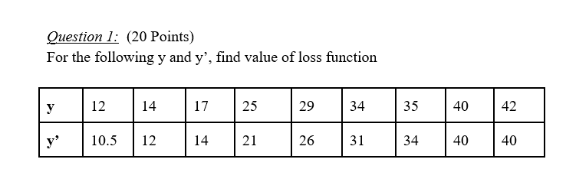
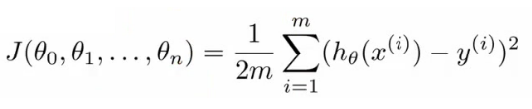
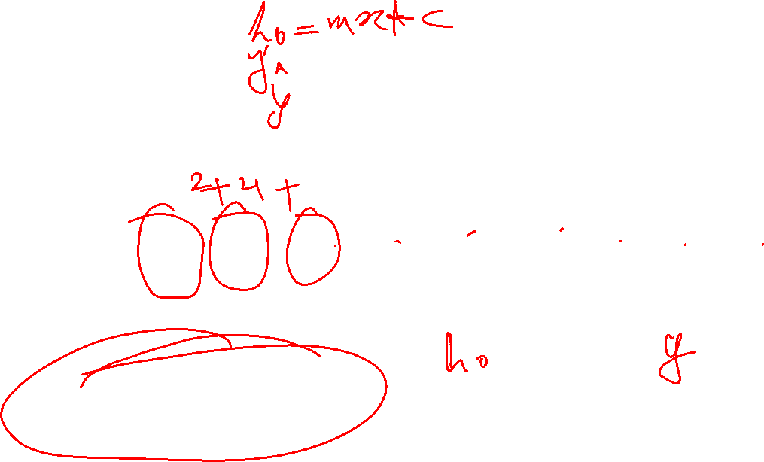
Question 1
Answer: 3.0 - 3.6
The Machine Learning & Deep Learning Show: Lecture 02

Slide 4
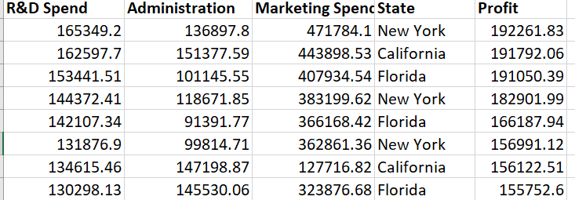
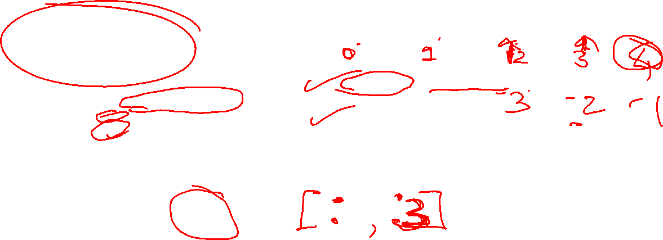
Question 2
import numpy as np
import matplotlib.pyplot as plt
import pandas as pd
#import data set
dataset= pd.read_csv(‘50_Startups.csv')
X= dataset.iloc[:,:3].values
Y= dataset.iloc[:,-1].values
#Splitting the data
from sklearn.model_selection import train_test_split
X_train, X_test, Y_train, Y_test
= train_test_split(X,Y,test_size=1/10)
dataset[“State"] = dataset[“State"].astype('category’)
dataset[“Encoded_State"] = dataset[“State"].cat.codes
The Machine Learning & Deep Learning Show: Lecture 02

Slide 5
Question 03
Great Idea! Let’s Discuss the Famous one!
http://vedantbahel.azurewebsites.net/

Slide 6
We will learn about how to deploy your Startup model in a Web App or Mobile App in Lecture 03

Slide 7
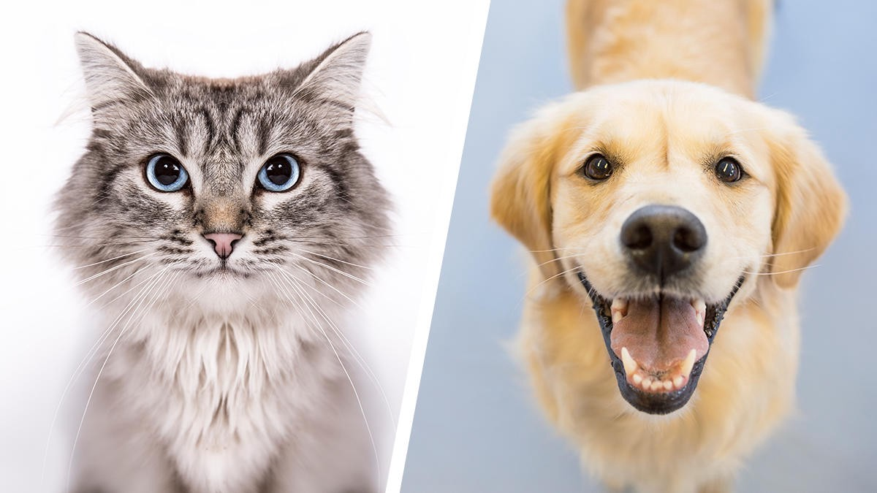
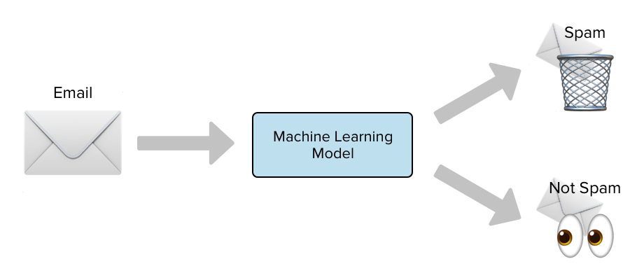
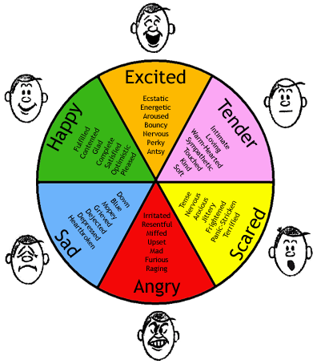
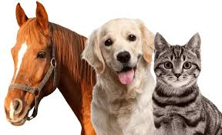
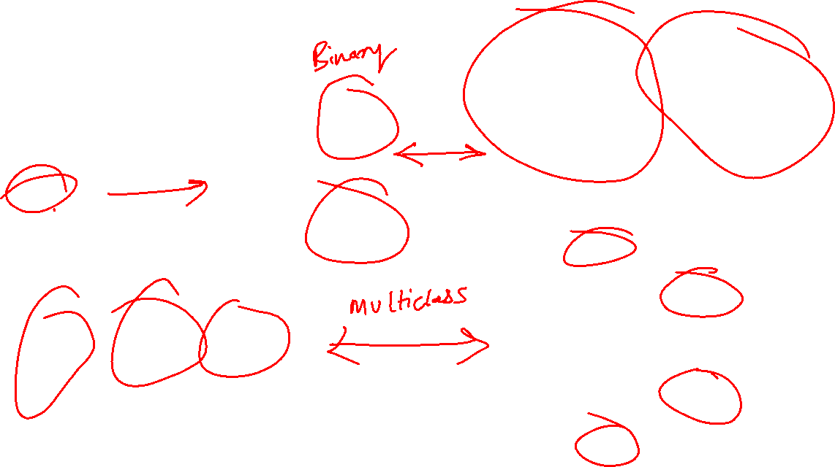
Classification
A Type of Supervised Learning
The Machine Learning & Deep Learning Show: Lecture 02

Slide 8

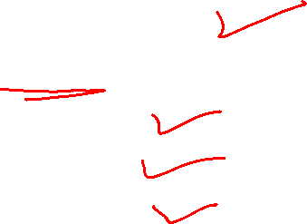
Algorithms
Logistics Regression
Naïve Bayes Classification
Decision Tree
Random Forest
KNN Classifier

Slide 9
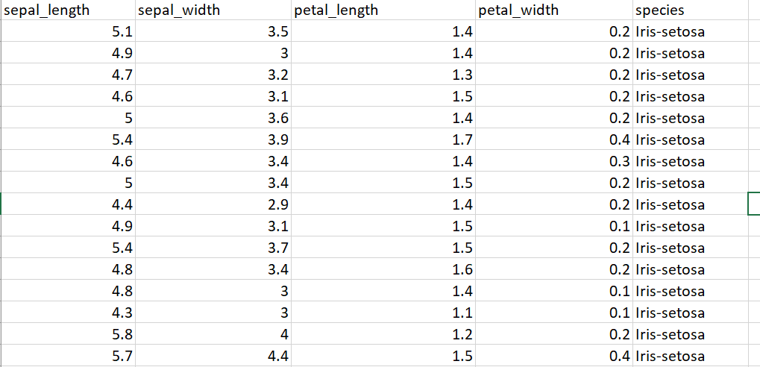
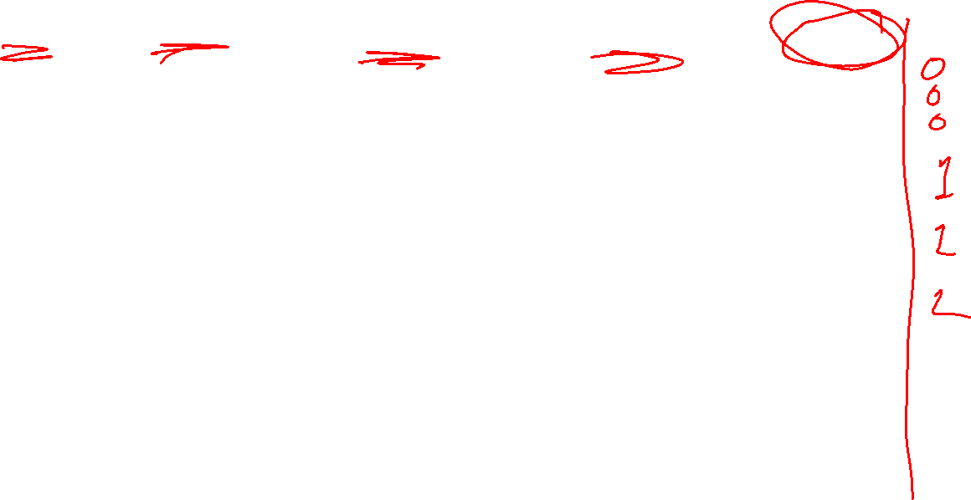
Dataset

Slide 10
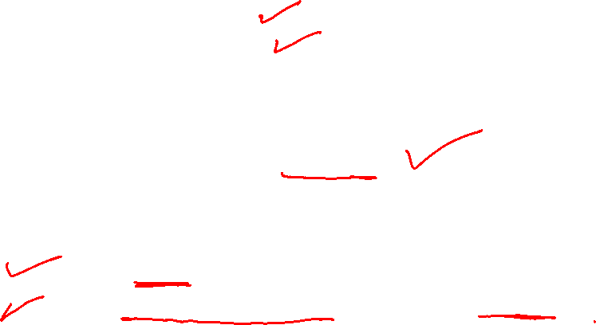
Model
#importing dataset
import numpy as np
import pandas as pd
#importing data
dataset= pd.read_csv("IRIS.csv")
#encoding
dataset["species"] = dataset["species"].astype('category')
dataset["Encoded_Species"] = dataset["species"].cat.codes

Slide 11
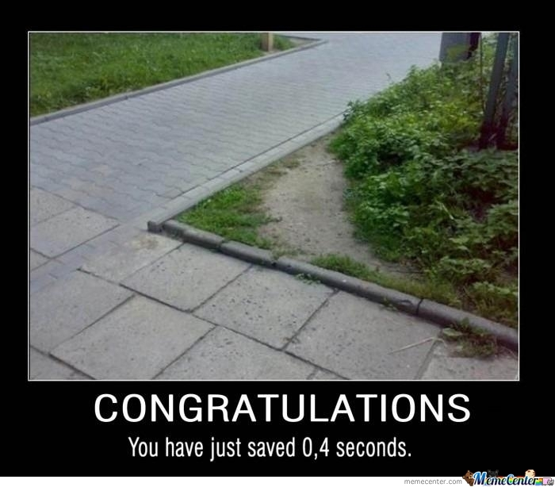
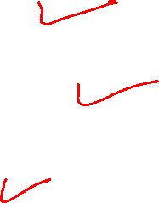
#define X & Y
# Split train & test
#Fit Model
#Confusion Matrix
By not writing the codes

Slide 12
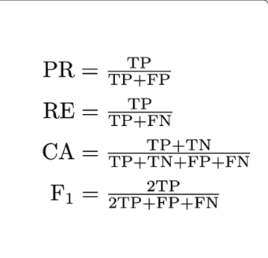
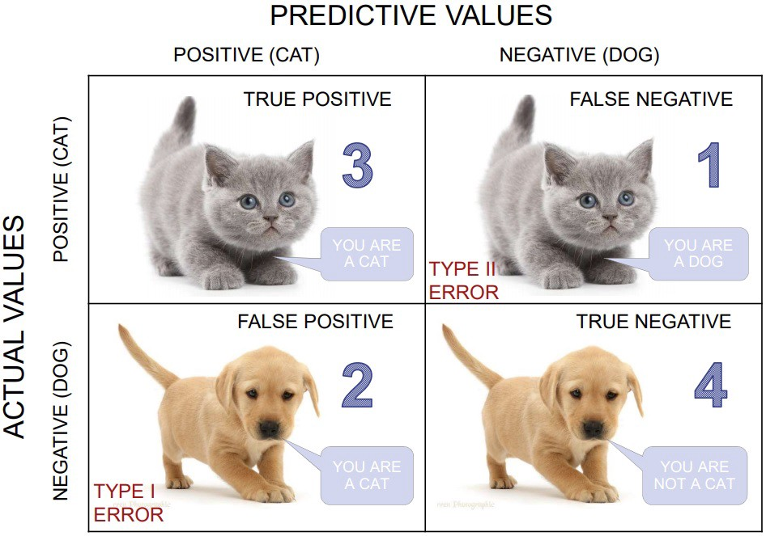
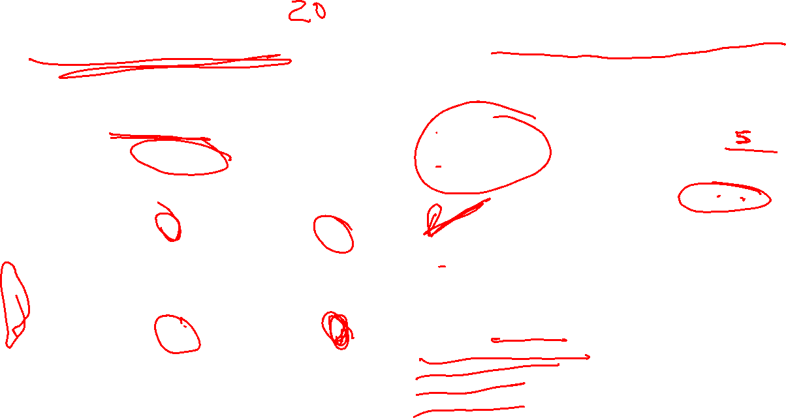
Confusion Matrix
F1 Score is the weighted average of Precision and Recall
Suppose: Cat & Dog Classifier
12 Samples
Precision
Recall
Accuracy
F1 Score
4
2
1
5
Precision is the ratio of correctly predicted positive observations to the total predicted positive observations.
Recall is the ratio of correctly predicted positive observations to the all observations in actual class

Slide 13
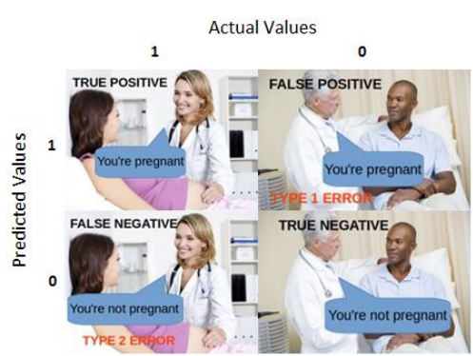

Slide 14
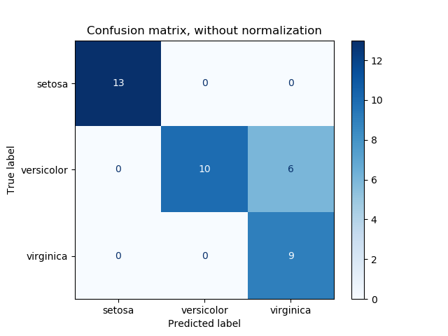
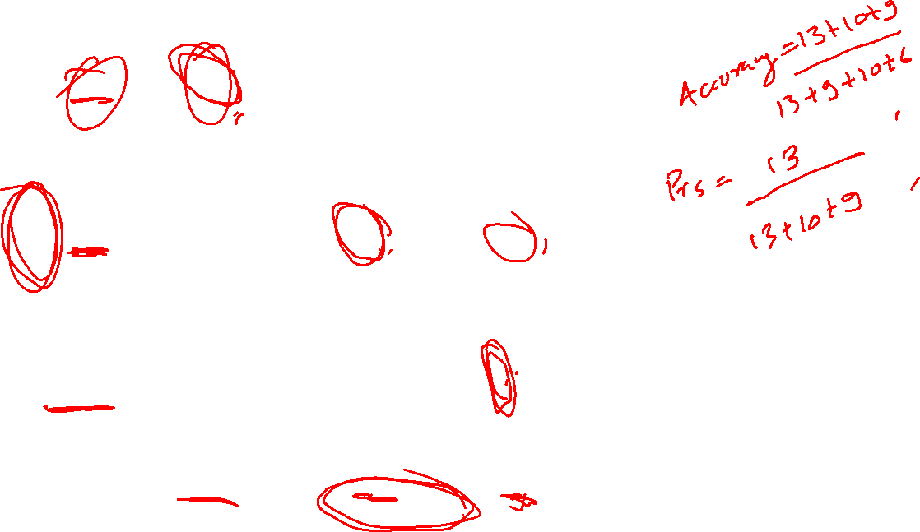

Slide 15
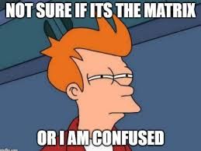
Confusion Matrix​

Slide 16
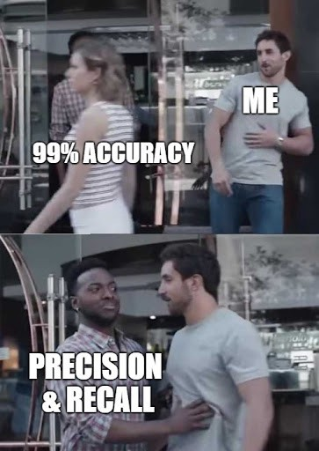

Slide 17
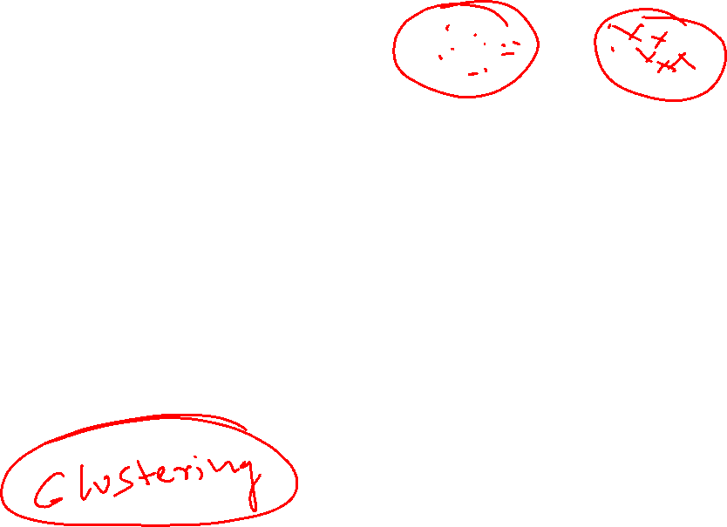
Un-supervised Learning
Unsupervised learning is a type of machine learning algorithm used to draw inferences from datasets consisting of input data without labeled responses.
The most common unsupervised learning method is cluster analysis, which is used for exploratory data analysis to find hidden patterns or grouping in data.
The Machine Learning & Deep Learning Show: Lecture 02

Slide 18
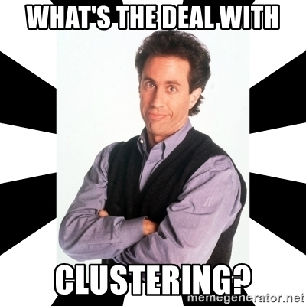
The Machine Learning & Deep Learning Show: Lecture 02

Slide 19
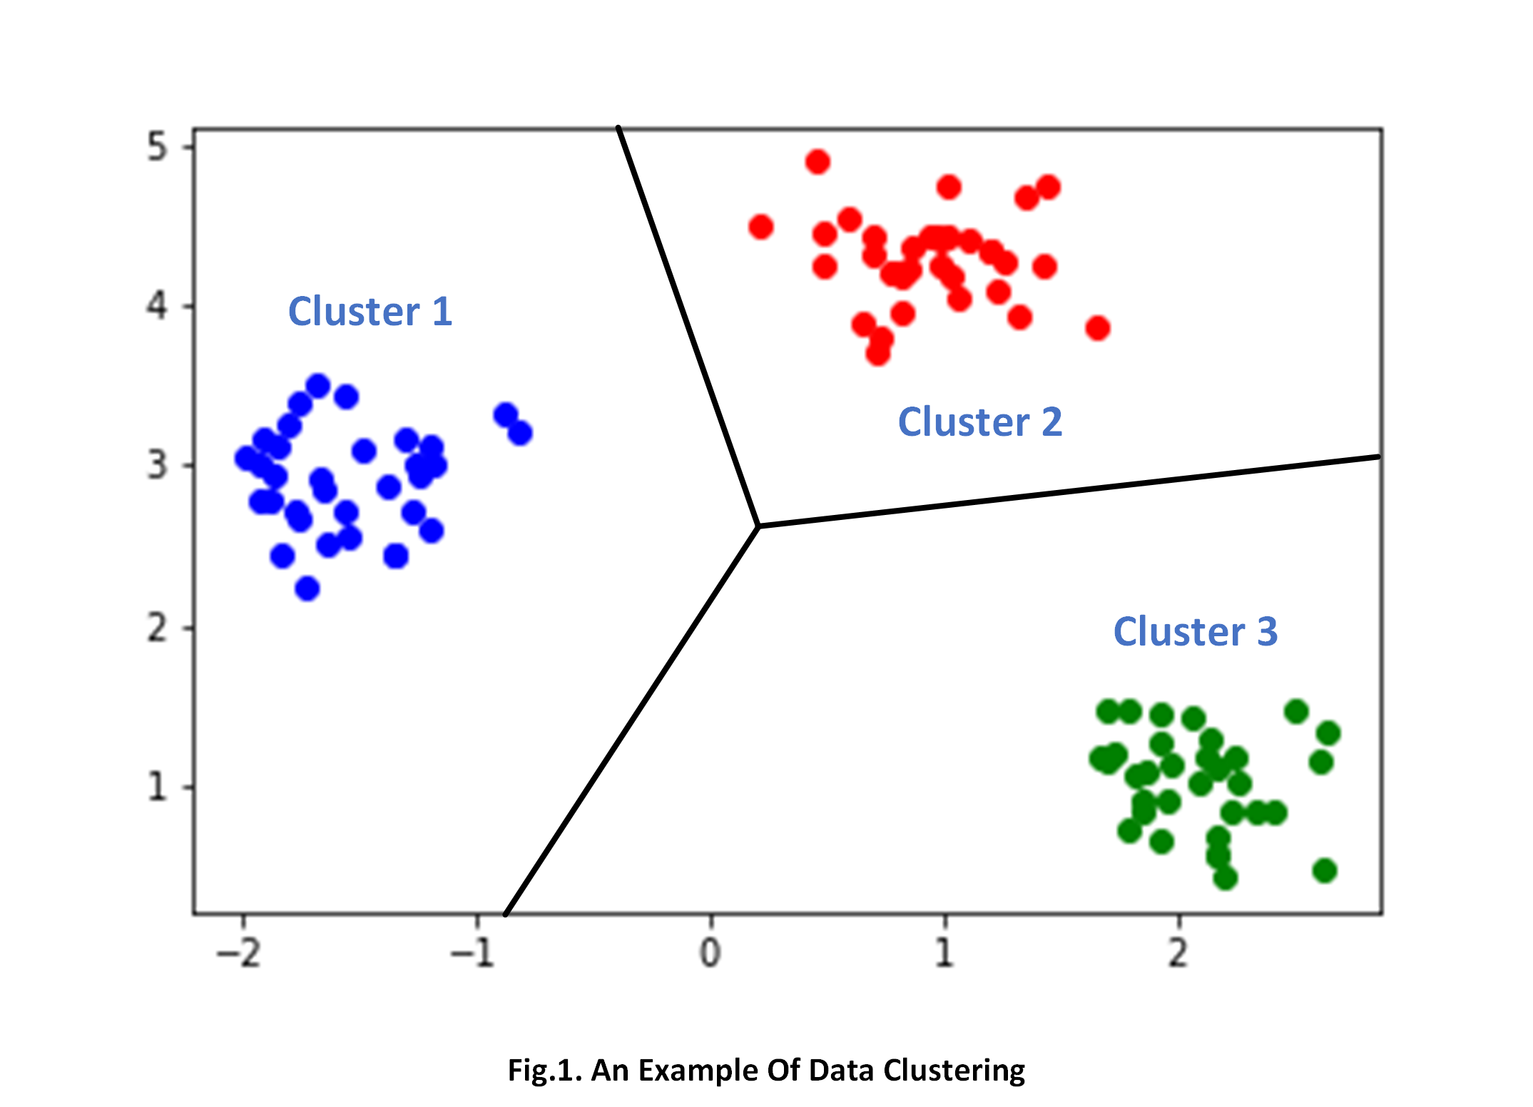
Clustering
Clustering means determining how closely related items are to each other, and arranging them to form clusters of related data items.
Clustering is the task of dividing the population or data points into a number of groups such that data points in the same groups are more similar to other data points in the same group and dissimilar to the data points in other groups.
The Machine Learning & Deep Learning Show: Lecture 02

Slide 20

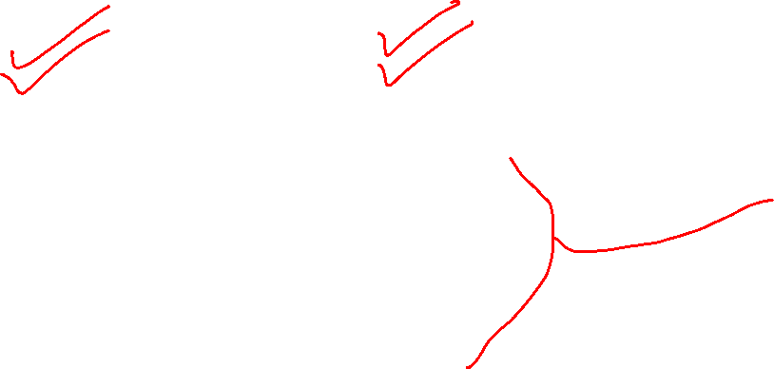
Clustering is a very simple algorithm which clusters the data into a number of clusters. The above image from PyPR is an example of Clustering.
The Machine Learning & Deep Learning Show: Lecture 02

Slide 21
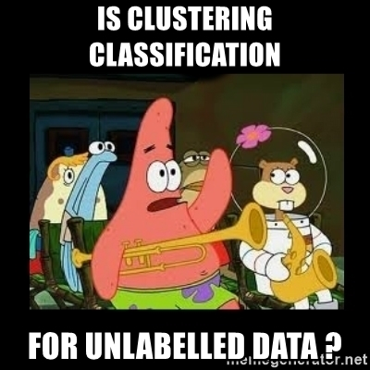
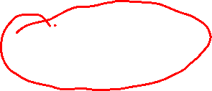
As the examples are unlabeled, clustering relies on unsupervised machine learning. If the examples are labeled, then clustering becomes classification.
The Machine Learning & Deep Learning Show: Lecture 02

Slide 22
Applications of Clustering in different fields
Marketing : It can be used to characterize & discover customer segments for marketing purposes.
Biology : It can be used for classification among different species of plants and animals.
Libraries : It is used in clustering different books on the basis of topics and information.
Insurance : It is used to acknowledge the customers, their policies and identifying the frauds.
The Machine Learning & Deep Learning Show: Lecture 02

Slide 23
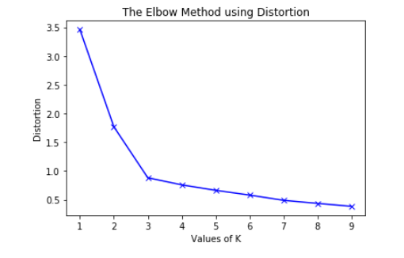
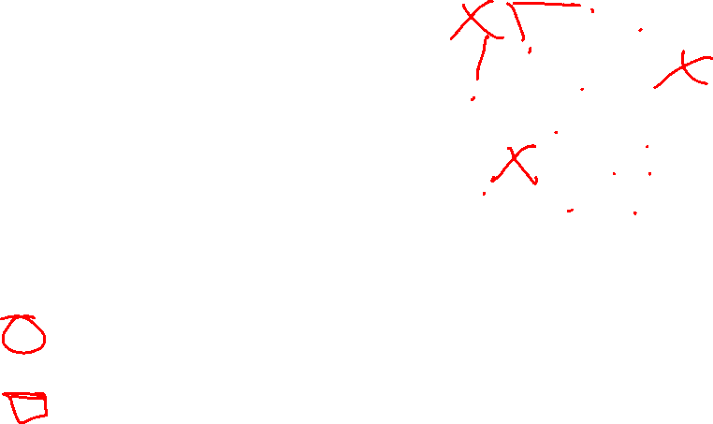
Elbow Method
Inertia: It is the sum of squared distances of samples to their closest cluster center.
The Machine Learning & Deep Learning Show: Lecture 02

Slide 24
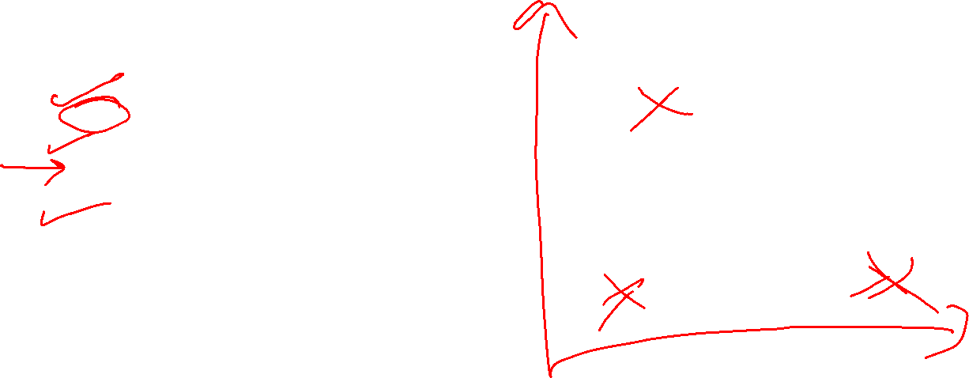
Code from Scratch
# Number of clusters
k = 3
# X coordinates of random centroids
C_x = np.random.randint(0, np.max(X)-20, size=k)
# Y coordinates of random centroids
C_y = np.random.randint(0, np.max(X)-20, size=k)
C = np.array(list(zip(C_x, C_y)), dtype=np.float32)
print("Initial Centroids")
print(C)
# Plotting along with the Centroids
plt.scatter(f1, f2, c='#050505', s=7)
plt.scatter(C_x, C_y, marker='*', s=200, c='g')
The Machine Learning & Deep Learning Show: Lecture 02

Slide 25
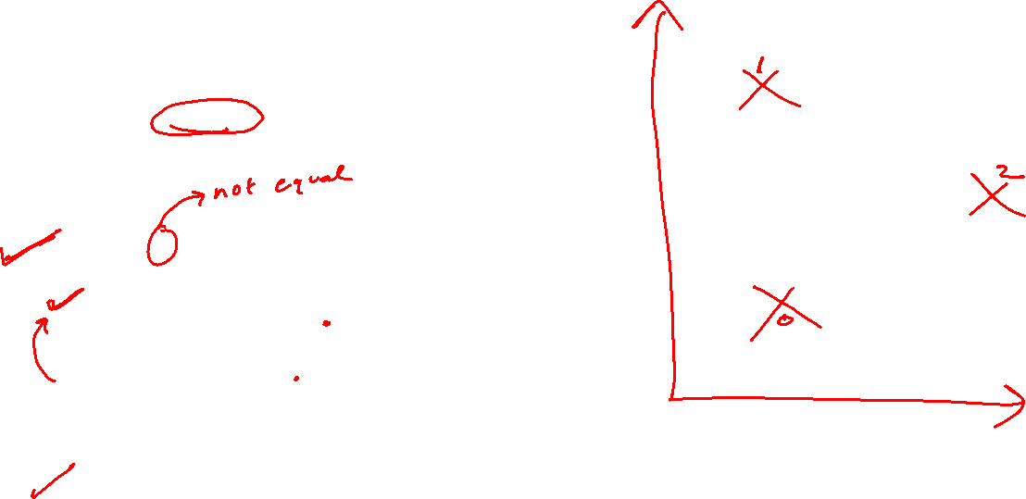
# To store the value of centroids when it updates
C_old = np.zeros(C.shape)
# Cluster Lables(0, 1, 2)
clusters = np.zeros(len(X))
# Error func. - Distance between new centroids and old centroids
error = dist(C, C_old, None)
# Loop will run till the error becomes zero
while error != 0:
# Assigning each value to its closest cluster
for i in range(len(X)):
distances = dist(X[i], C)
cluster = np.argmin(distances)
clusters[i] = cluster
# Storing the old centroid values
C_old = deepcopy(C)
# Finding the new centroids by taking the average value
for i in range(k):
points = [X[j] for j in range(len(X)) if clusters[j] == i]
C[i] = np.mean(points, axis=0)
error = dist(C, C_old, None)
The Machine Learning & Deep Learning Show: Lecture 02

Slide 26
K-Means Algorithm
K-means algorithm is an iterative algorithm that tries to partition the dataset into ‘k’ pre-defined distinct non-overlapping subgroups (clusters) where each data point belongs to only one group.
It is the simplest unsupervised learning algorithm that solves clustering problem
The Machine Learning & Deep Learning Show: Lecture 02

Slide 27
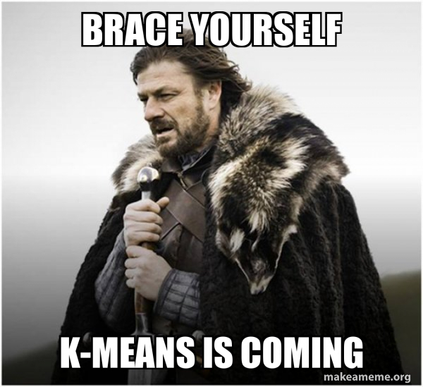
K-Means Algorithm
The Machine Learning & Deep Learning Show: Lecture 02

Slide 28
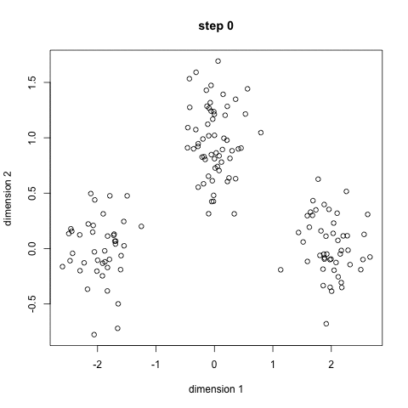
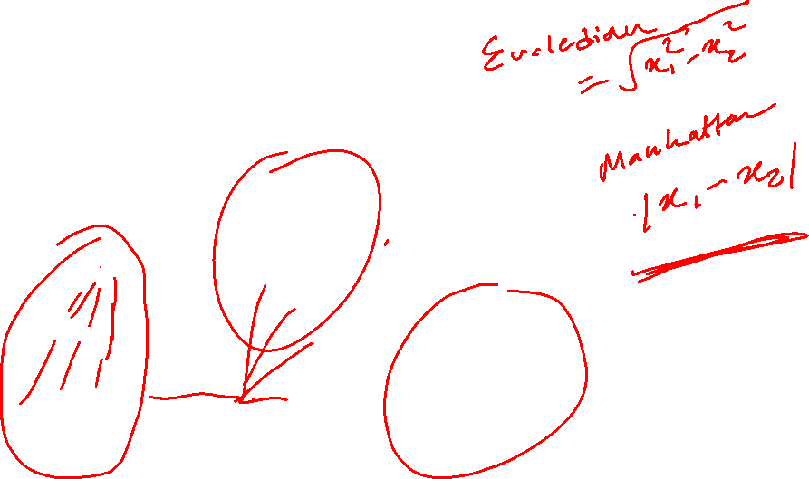
K-Means Algorithm
The Machine Learning & Deep Learning Show: Lecture 02

Slide 29
K-Means Algorithm
Our algorithm works as follows, assuming we have inputs x_1, x_2, x_3, ..., ,...,xn and value of K
Step 1 - Pick K random points as cluster centers called centroids.
Step 2 - Assign each x_i to nearest cluster by calculating its distance to each centroid.
Step 3 - Find new cluster center by taking the average of the assigned points.
Step 4 - Repeat Step 2 and 3 until none of the cluster assignments change.
The Machine Learning & Deep Learning Show: Lecture 02

Slide 30
K-Means Algorithm
The Machine Learning & Deep Learning Show: Lecture 02

Slide 31
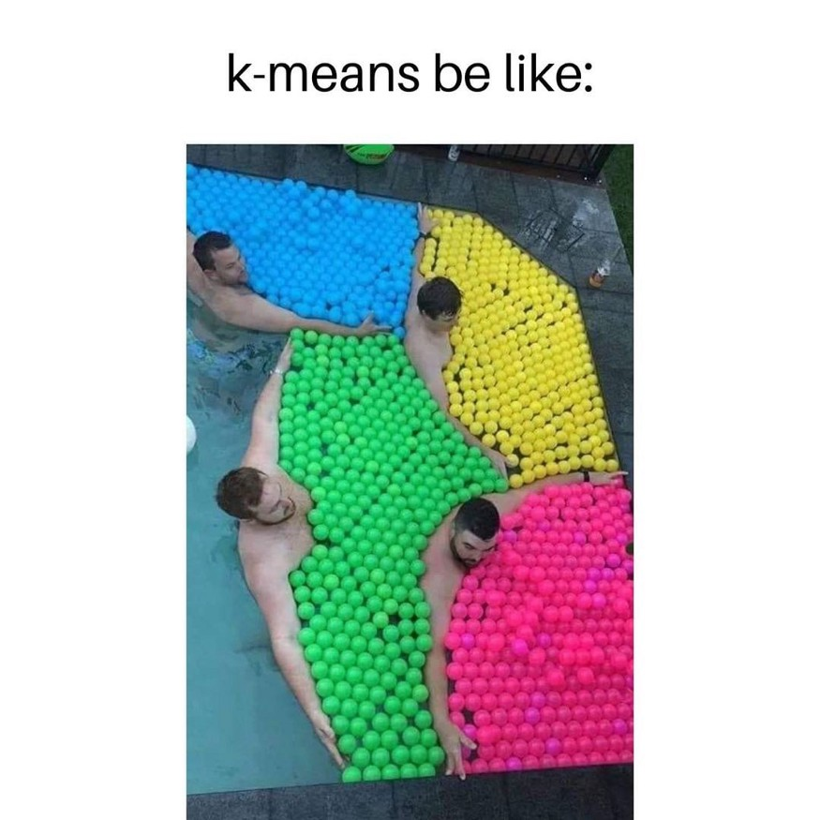
K-Means Algorithm
The Machine Learning & Deep Learning Show: Lecture 02

Slide 32

Other Clustering Algorithms
The Machine Learning & Deep Learning Show: Lecture 02

Slide 33


Slide 34
Code: Linear regression
import numpy as np
import pandas as pd
from matplotlib import pyplot as plt
# Importing the dataset
data = pd.read_csv('xclara.csv')
print("Input Data and Shape")
print(data.shape)
data.head()
# Getting the values and plotting it
f1 = data['V1'].values
f2 = data['V2'].values
X = np.array(list(zip(f1, f2)))
plt.scatter(f1, f2, c='black', s=7)

Slide 35
Code: Linear regression
from sklearn.cluster import KMeans
# Number of clusters
kmeans = KMeans(n_clusters=3)
# Fitting the input data
kmeans = kmeans.fit(X)
# Getting the cluster labels
labels = kmeans.predict(X)
# Centroid values
centroids = kmeans.cluster_centers_
print("Centroid values")
print(centroids)

Slide 36
Code: Linear regression
#no. of clusters
k= 3
#plotting the clusters
colors = ['r', 'g', 'b', 'y', 'c', 'm']
fig, ax = plt.subplots()
for i in range(k):
points = np.array([X[j] for j in range(len(X)) if labels[j] == i])
ax.scatter(points[:, 0], points[:, 1], c=colors[i], s=7)
#plotting the centroids
ax.scatter(centroids[:, 0], centroids[:, 1], marker='*', s=200, c='#050505')

Slide 37
Assignment 2

Slide 38

Gift For All
Eligibility
Submitted Assignment 01
Is not a Microsoft Student Partner

Slide 39
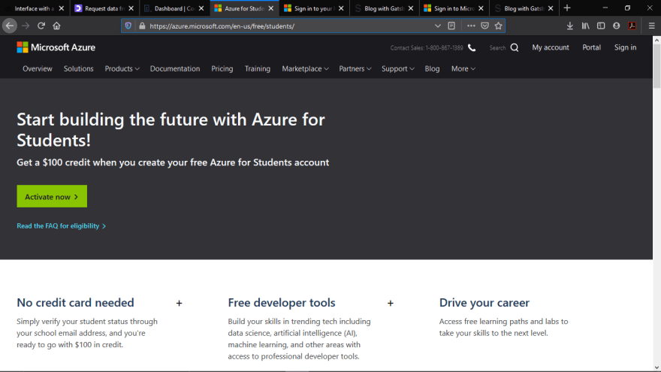
Redeem The Gift!
https://aka.ms/azure4student

Slide 40
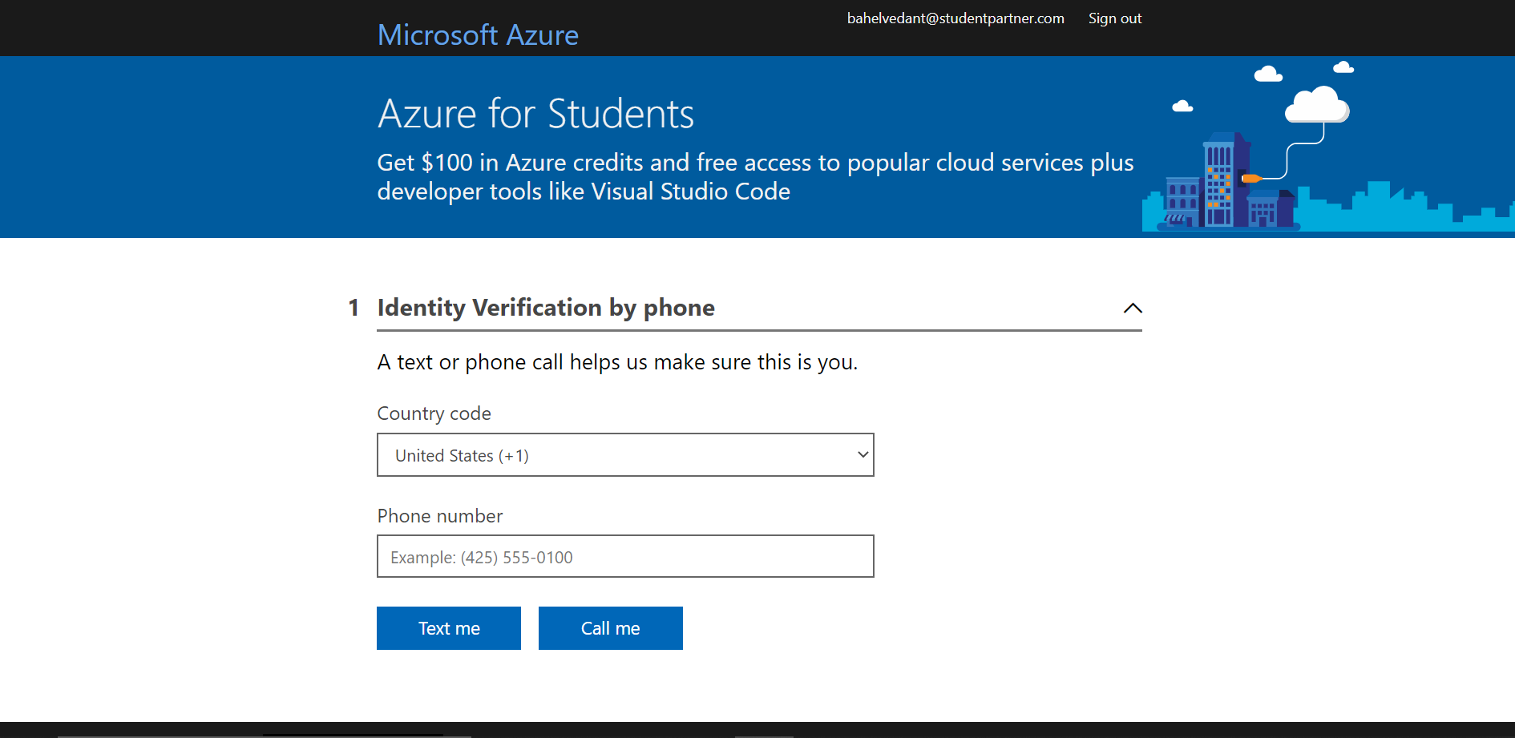

Slide 41
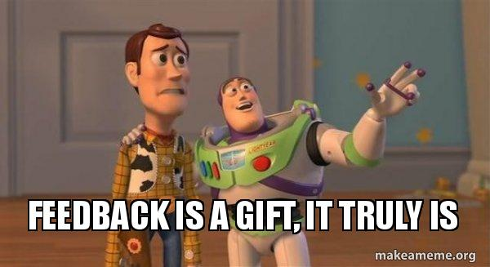
Return Gift

Slide 42
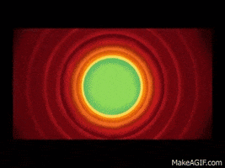
That's all Folks !
​

